Slide 1
Effect of Exercises on Endorphin
Levels
Nathan, Tinn, Naren
Group T

Slide 2
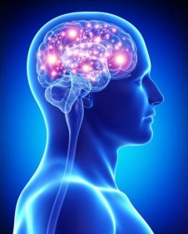
Literature
“Beta-endorphins are chemicals produced by the nervous system to manage pain or stress” (Schwarz). Studies have shown that most forms of exercise increase blood Beta-endorphin levels after 30 minutes. When the exercise intensity reaches the anaerobic threshold, there is an elevation of serum lactate level. Another factor that affect endorphin levels is age during exercise.

Slide 3

Research Question
Knowing that endorphins aid in pain management, and the literature shows that differences in age and participation in exercise can elevate endorphin levels in the blood, we wanted to investigate which exercise would be the most effective for increasing blood endorphin levels. In addition, we wanted to see if the effect was consistent across different age groups.

Slide 4
Design
Randomized Basic Factorial Design with two factors
1st Factor: Exercise - Swim Freestyle, Run Outdoors, Strength Training
2nd Factor: Age group - 7-25, 26-50, 51+
Interaction between age group and exercise types
Response factor: Difference in Endorphins level (pg/mL)
Held constant factors : Sex (Male), City (Arcadia), Time (30 min)
Benchmark df = 1
Exercise df = 2
Age df = 2
Interaction df = 4
Error df = 189

Slide 5
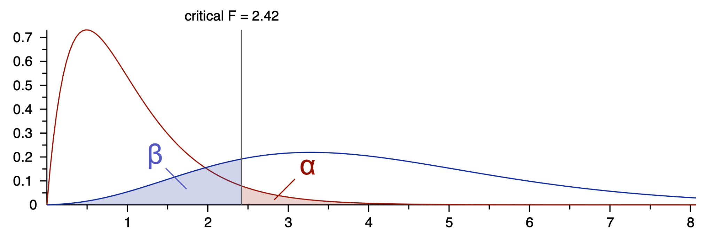
Sampling method
Recruited participants based on age groups
Randomly assigned participants to one of exercises
Sample size determination using G*Power
Power of 80%
Alpha of 0.05
Effect size of 0.25
G*Power estimation of 196
Round up to 198
22 participants/group

Slide 6
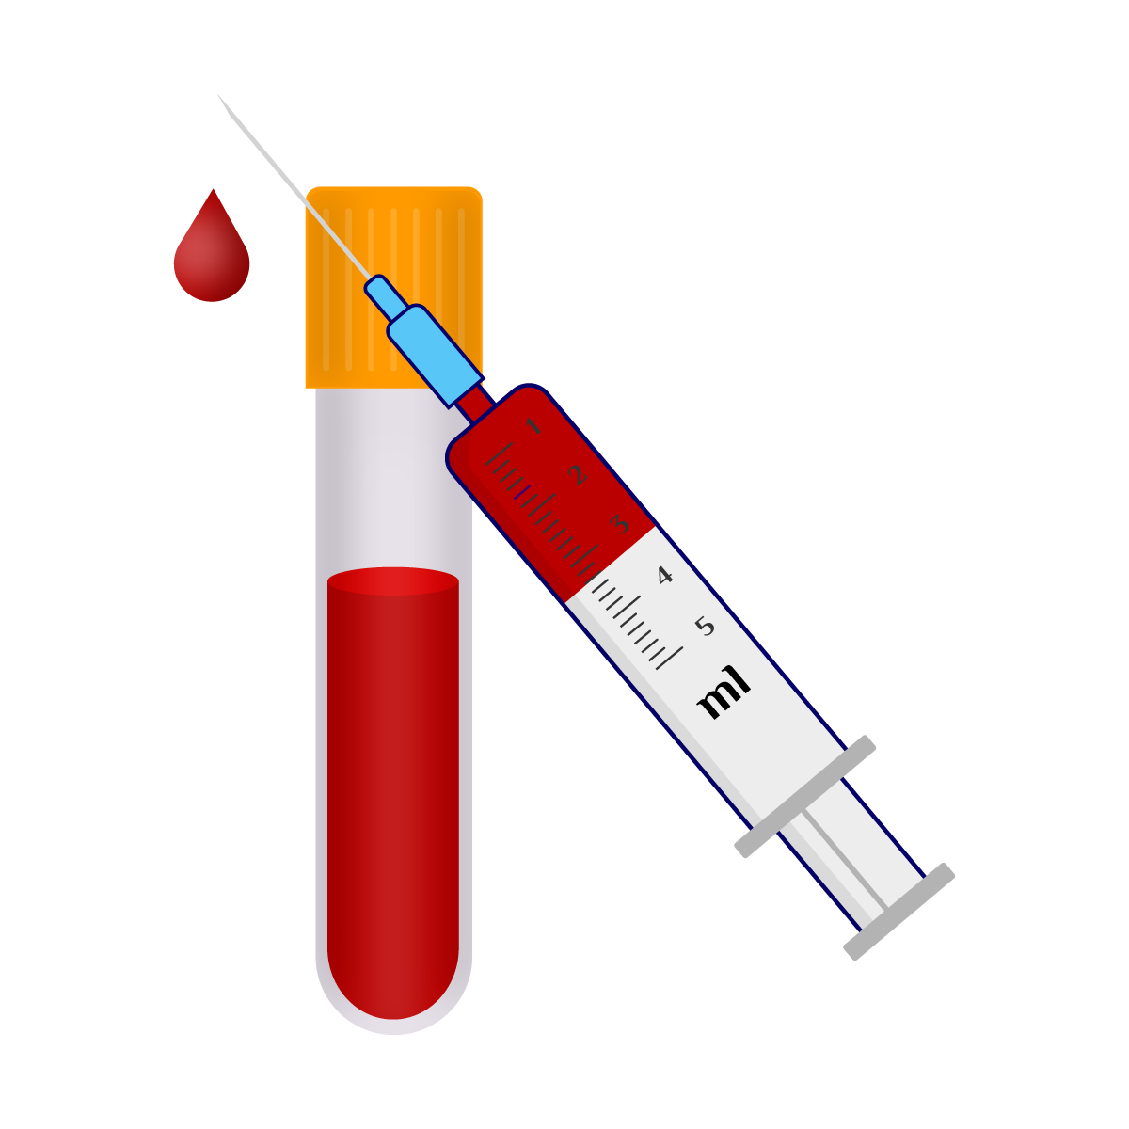
Method
01
02
03
Measure initial Endorphins
Do randomly assigned exercise 30 min
Measure Endorphins after

Slide 7
Data Description
Name - Character value of full name for each Islander sampled
Age Group - Factor storing the age group of each Islander sampled (1 - (0 - 25 years), 2 - (26-50 years), 3 (51 + years))
Initial Endorphin Levels (pg / mL) - Numeric value of blood endorphin level prior to exercise
Exercise - Factor for type of exercise (“SWIM”, “RUN”, or “STRETCH”)
Endorphin Levels After (pg / mL) - Numeric value of blood endorphin level after exercise
Endorphin Level Change (pg / mL) - Numeric value obtained from Endorphin Levels After - Initial Endorphin Levels

Slide 8
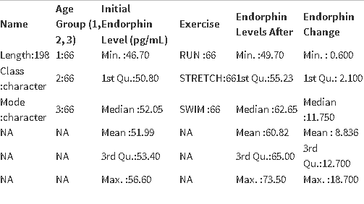
Data Summary

Slide 9
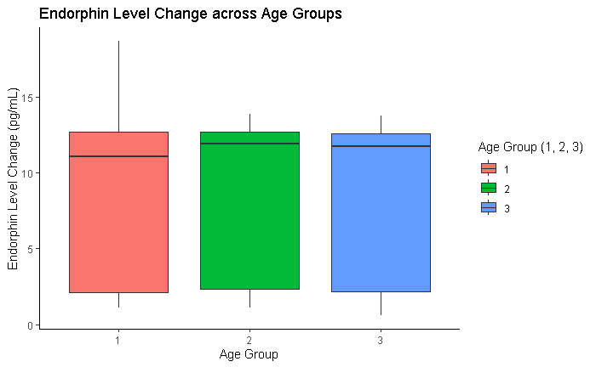
Comparison of Endorphin Level Changes across Age Groups

Slide 10
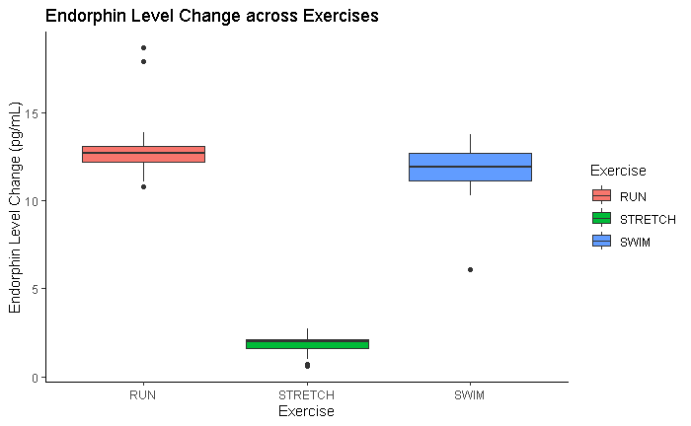
Comparison of Endorphin Level Changes across Exercises

Slide 11
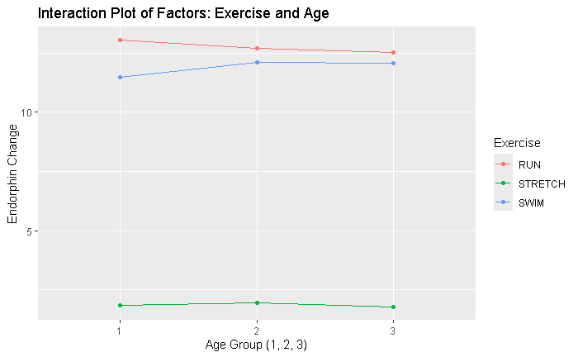
Do we consider the interaction?

Slide 12

ANOVA Results of Full Model

Slide 13
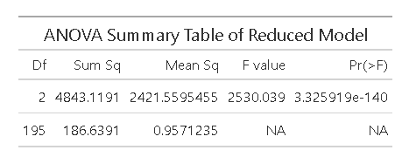
ANOVA Results of Reduced Model

Slide 14
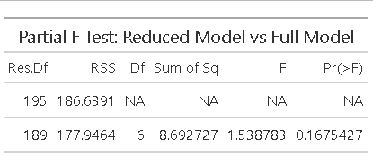
Which Model is better?

Slide 15
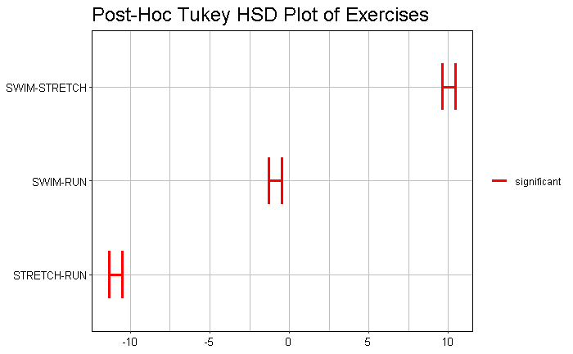
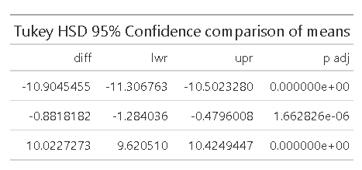
Post-Hoc Analysis of Exercise

Slide 16
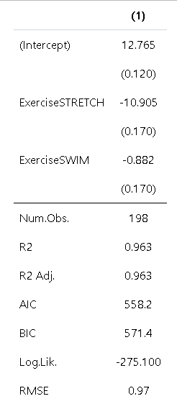
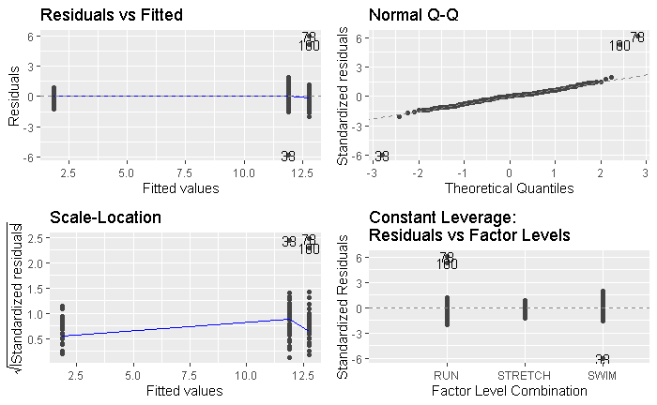
Final Linear Model

Slide 17
Final equations
Final equation:
Model Fit Equation:

Slide 18
Conclusion
Under the assumption that alpha level is 0.05, the type of exercise is a significant predictor variable and age was not a significant predictor variable for the difference in endorphin levels.
However, based on the Tukey HSD and the comparison of exercises, swimming and running produce a high difference in endorphin levels, but stretching had a relatively low difference in endorphin levels. In conclusion, not all forms of exercise are equivalent in boosting endorphin levels and by extension helping with pain management..
Future research can investigate the effect of factors that were held constant in the study.

Slide 19
Future Research Questions
Is the sex of the person a significant variable for the change in endorphin levels?
Are the locations of the subjects a significant variable for the change in endorphin levels?
Would a person’s level of physical activity influence their change in blood endorphin levels?

Slide 20
References
Research Paper on the Release of Endorphin Hormone and its effects on our body and moods from 2011 (Dr. P B Rokade)
https://www.semanticscholar.org/paper/Release-of-Endomorphin-Hormone-and-Its-Effects-on-A-Rokade/d9d6a77f113bb866ea1588edf646a60e25ca1755?p2df
Journal about Changed in Endorphin Levels in Response to Aerobic and Anaerobic Exercise (Lothar Schwarz and Wilfried Kindermann)
https://link.springer.com/article/10.2165/00007256-199213010-00003
Research Article on the influence of Physical and Mental Training on Beta-Endorphin level and Pain receptors (Tamas Bender)
https://onlinelibrary.wiley.com/doi/abs/10.1002/smi.892?casa_token=c21BfIBNmn4AAAAA%3AxQ89rJnCjxX8g0oCE98A0YhUyAS5q9_cR0MhnTNKSiyiqSu_WaeJXcz-FYHlpgVd0R7uboI9i72aNQ
Age-related changes in central nervous system beta-endorphin and ACTH (S R Gambert)
https://pubmed.ncbi.nlm.nih.gov/6252495/

